Slide 1




F1 Data Analysis Source: : https://www.kaggle.com/datasets/rohanrao/formula-1-world-championship-1950-2020 Dataset: f1_analytics_dataset Email: ankitabhamidimarri21804@gmail.com Phone : 6304450121 LinkedIn : https://www.linkedin.com/in/ankita-bhamidimarri/
F1 Data Analysis Using PySpark
Bharadwaj Kollepara

Slide 2
Introduction
This presentation provides an analysis of the Formula 1 dataset using PySpark, covering:
Dataset Structure and Uniqueness
Nine Core Analytics
Three Visualizations
Key Observations and Insights
Dataset Observation
Conclusion

Slide 3
Initial Analysis of the Dataset
Dataset Structure & Uniqueness
Data includes races, results, drivers, constructors, circuits.
Columns: driverId, constructorId, grid, positionOrder, points, laps, year, circuit, country.
Data spans multiple decades, clean schema with minor missing values (mainly DNFs).
Joins between tables provide a complete race history.

Slide 4
Nine Core Analytics
1. Unique Counts
Computed distinct counts of drivers, constructors, and circuits.
Revealed dataset breadth: hundreds of drivers, dozens of teams, multiple circuits.
2. Top Drivers by Total Points
Grouped by driverId and summed points.
Identified all-time leaders in points.
Highlights dominant eras for Hamilton, Vettel, Verstappen, etc.

Slide 5
Nine Core Analytics
3. Top Teams by Total Points
Aggregated points at constructor level.
Ferrari and Mercedes dominate historically.
Red Bull rises sharply in the hybrid era.
4. Drivers with Most Wins
Counted first-place finishes.
Schumacher, Hamilton, and Vettel top the win charts.
Provides direct measure of race victories beyond total points.

Slide 6
Nine Core Analytics
5. Podium Finishes per Driver
Counted finishes in positions 1–3.
Shows consistency: not only winning, but repeatedly finishing near the front.
Valuable for identifying drivers with stable high performance.
6. Average Grid vs Average Finish
Calculated average starting position and finishing position per driver.
Drivers with better finishing averages than grid averages demonstrate strong racecraft.
Highlights those who consistently gain positions.

Slide 7
Nine Core Analytics
7. Season-wise Driver Points (2023–2024)
Aggregated points by year and driver.
Focused on 2023–2024 to highlight recent competitive landscape.
Showcases Verstappen and Hamilton’s continued performance.
8. Country-wise Race Distribution
Counted races grouped by host country.
UK, Italy, and USA show high representation.
Highlights F1’s global reach but with strong European roots.

Slide 8
Nine Core Analytics
9. Correlation of Points with Grid & Laps
Computed Pearson correlations.
Negative correlation between grid position and points: starting higher yields more points.
Weak correlation between laps completed and points: reliability matters but doesn’t guarantee high points.

Slide 9
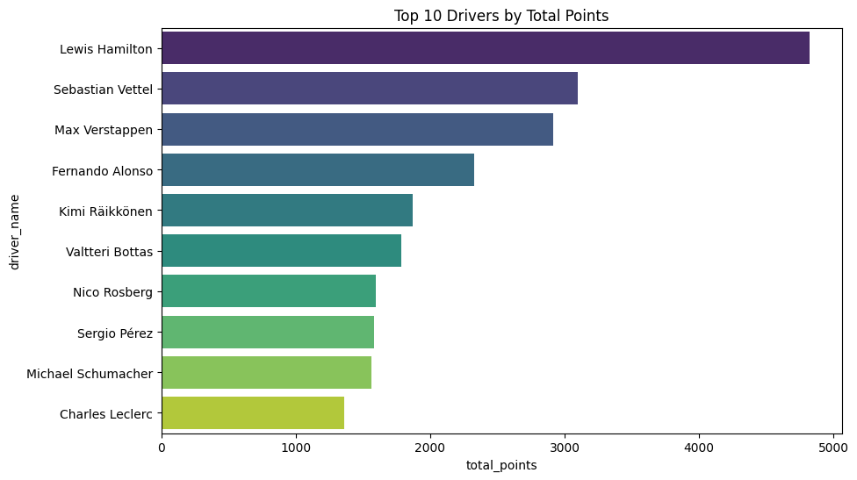
Three Visualizations
Plot 1: Top 10 Drivers by Total Points
Horizontal bar chart of drivers with most career points.
Visualizes dominance eras clearly.
Hamilton, Vettel, Verstappen emerge as top performers.

Slide 10
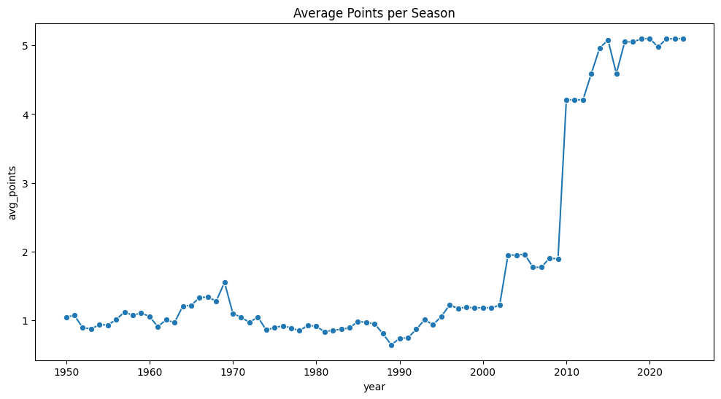
Three Visualizations
Plot 2: Average Points per Season
Line chart of average points per year.
Shows how scoring patterns evolve with regulation changes.
Reflects F1’s changing competitiveness over time.

Slide 11
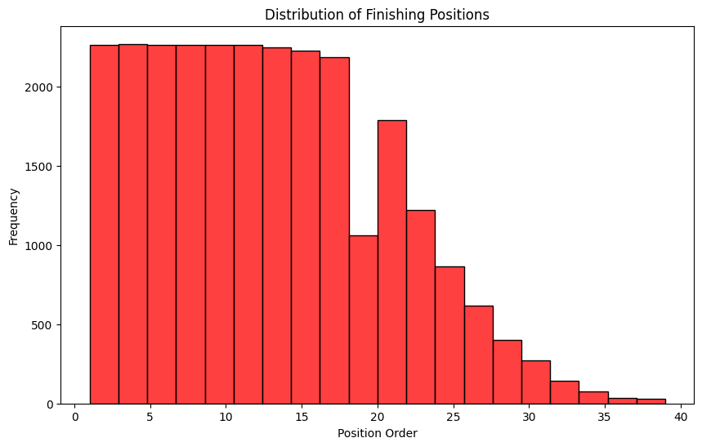
Three Visualizations
Plot 3: Distribution of Finishing Positions
Histogram of positionOrder across dataset.
Shows most races end with full 20-car classification.
Demonstrates typical finishing spread with few wins, many midfield finishes.

Slide 12
Key Observations and Insights
Driver Performance
Hamilton, Vettel, and Verstappen lead in total points and wins.
Podium finishes reveal consistency beyond outright victories.
Constructor Dominance
Ferrari and Mercedes dominate across eras.
Red Bull’s sharp rise is evident in the hybrid era.
Race Dynamics
Strong correlation between starting grid and finishing position.
DNFs heavily impact outcomes; reliability is critical.
Season & Geography
2023–2024 highlight Verstappen’s continued dominance.
UK, Italy, and USA host the largest share of races.
Statistical Insights
Negative correlation: higher grid start → more points.
Laps completed weakly correlate with points (finishing ≠ success).

Slide 13
Dataset Observation
Source: Formula 1 dataset (CSV files – races, results, drivers, constructors, circuits)
Size & Scope: Thousands of race records spanning multiple decades
Key Identifiers: resultId, raceId, driverId, constructorId
Race Details: grid, position, points, laps, time, milliseconds
Performance Metrics: fastestLap, fastestLapTime, fastestLapSpeed
Metadata: driverRef, surname, dob, nationality
Driver Attributes: driverRef, surname, dob, nationality

Slide 14
Conclusion
The Formula 1 dataset offers a rich and detailed view of races, drivers, and constructors over multiple decades. Through PySpark analytics, we explored patterns in driver dominance, constructor performance, and race dynamics, revealing how grid positions, consistency, and reliability strongly influence outcomes. Visualizations further highlighted trends in points, wins, podiums, and finishing positions, bringing clarity to both individual and team performance. Overall, this analysis demonstrates the value of big data tools in uncovering meaningful insights from complex sports datasets, while also opening opportunities for future predictive modeling with additional factors such as weather, pit stops, and tyre strategies.

